Slide 1
Data Warehouses
Analyzing and Exporting Data

Slide 2
Data Warehouses: Analyzing and Exporting Data
Contents
Data Warehouses and Data Cubes
Why have Data Warehouses
Existing and New Data Warehouses
Data Warehouses in Navigator FM
Activating and Maintaining Data Warehouses

Slide 3
What is a Data Warehouse?
Data Warehouses: Analyzing and Exporting Data
Data Optimized for Analytics and Business Decisions
Designed for Querying by End Users
Detail Level Data
Designed for Extraction to Make Business Decisions
Reduce Reliance on Custom Programming

Slide 4
What is a Data Cube?
Data Warehouses: Analyzing and Exporting Data
Data Optimized for Analytics
Summarized Level Data
Think F4 screens
Reduces Flexibility for Data Extraction
Requires Processing to do Summarization

Slide 5
Why do we have Data Warehouses?
Data Warehouses: Analyzing and Exporting Data
Dancik Database Structure
Dancik Database
Contains approximately 3000 physical files (tables)
Continues to grow daily
Normalized Database
Non-Externalized tables
You Don’t Want to Have to Learn All of Them…

Slide 6
How You See Dancik Database

Slide 7
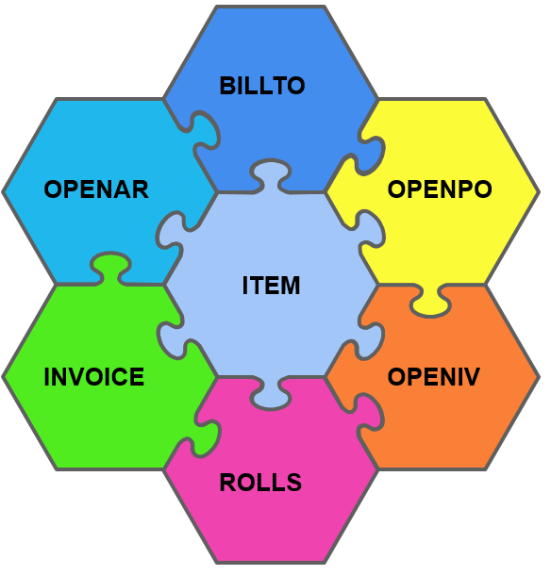
Data Warehouses: Analyzing and Exporting Data
How We See the Dancik Database

Slide 8
Data Warehouses: Analyzing and Exporting Data
Make Data More Accessible - Triggers
Trigger
Trigger
Trigger
Trigger

Slide 9
Data Warehouses: Analyzing and Exporting Data
How We Want You to See the Dancik Data
Order and Invoice Data - Externalized
Trigger
Trigger
Trigger
Trigger
OPENPO@H
Header Data
INVOICEC
Header Data
OPENPO@D
Detail Line Data
INVOICED
Detail Line Data
INVOICEM
Misc Line Data
OPENPO@M
Misc Line Data
INVOICET
Total Line Data
DW0001F
Sales Data Warehouse
NAVIGATOR
RADAR

Slide 10
Data Warehouses: Analyzing and Exporting Data
How We Want You to See the Dancik Data
Item and Inventory Data - Externalized
Item File Data
Inventory Transaction Data
Trigger
Trigger
Trigger
Trigger
ITEM
OPENIV
DW0006F
Data Warehouse
DW0008F
Data Warehouse
Serialized Data
ROLLS
DW0007F
Data Warehouse

Slide 11
Why do we have Data Warehouses?
Data Warehouses: Analyzing and Exporting Data
Make Programming Development More Efficient
Dancik Uses These Data Warehouses
Navigator Uses These Data Warehouses
RADAR Uses These Data Warehouses
You can stop asking about OPENPO now, we don’t use it ☺
Data Warehouses are Documented Online
Data Warehousing Category

Slide 12
How do Data Warehouses update?
Data Warehouses: Analyzing and Exporting Data
Database Triggers
Operating system level triggers
Guarantee execution regardless of application
Reduces integrity complexity within the applications
Real-time updates

Slide 13
Existing Data Warehouse
Data Warehouses: Analyzing and Exporting Data
Invoices, Orders and Unprocessed orders
Also Called “Sales Data Warehouse”
This Data Warehouse is used for RADAR Sales Analysis
Now Accessible in Navigator FM
Added Some Requested Columns
Weight
GP% and GP$ With Funds
GP% and GP$ Without Funds

Slide 14
New Data Warehouses
Data Warehouses: Analyzing and Exporting Data
Item Data
Manufacturer Data Elements
Supplier Data Elements
Contains Associated “Codes” File Descriptions
Now accessible in Navigator FM

Slide 15
Item Data Warehouse
Data Warehouses: Analyzing and Exporting Data
Item (FIL 002)
DW0006F
Item Data Warehouse
Manufacturer (FIL 004)
Supplier (FIL 003)
Classes (FIL 019)

Slide 16
New Data Warehouses
Data Warehouses: Analyzing and Exporting Data
Serialized Inventory Data Warehouse
Item Data With Associated “Codes” File Descriptions
Item Data Elements
Item SKU Data Elements
Manufacturer Data Elements
Now accessible in Navigator FM

Slide 17
Serialized Inventory Data Warehouse
Data Warehouses: Analyzing and Exporting Data
DW0008F
Serialized Inventory Data Warehouse
Item (FIL 002)
Rolls (INV 001)
Manufacturer (FIL 004)
Item SKU (FIL 013)
Supplier (FIL 003)
Package (FIL 011)

Slide 18
New Data Warehouses
Data Warehouses: Analyzing and Exporting Data
Serialized Inventory Data Warehouse
All dates are in ISO date formats (CCYYMMDD)
Dataset only includes Serial Numbers with On-hand or Scheduled Quantities

Slide 19
New Data Warehouses
Data Warehouses: Analyzing and Exporting Data
Serialized Inventory Data Warehouse
Unit of Measures converted in the Dataset
First Unit of Measure is Native Unit of Measure
All available Packaging Unit of Measures are converted for you from Native Unit of Measure
On-Hand Quantity
Allocated Quantity
Held Quantity
Available Quantity
Scheduled Quantity

Slide 20
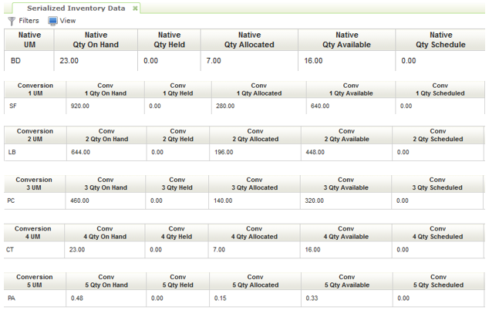
New Data Warehouses
Data Warehouses: Analyzing and Exporting Data

Slide 21
New Data Warehouses
Data Warehouses: Analyzing and Exporting Data
Inventory Transactions Data Warehouse
Unit of Measures converted in the Dataset.
First Unit of Measure is Native Unit of Measure
All available Packaging Unit of Measures are converted for you from Native Unit of Measure
All dates are in ISO date formats (CCYYMMDD)
Item data with associated “Codes” file descriptions
Accessible in Navigator FM
Initially loaded with transactions from 06-01-2015

Slide 22
Inventory Transaction Data Warehouse
Data Warehouses: Analyzing and Exporting Data
DW0007F
Inventory Transaction Data Warehouse
Item (FIL 002)
Openiv (INV 001)
Manufacturer (FIL 004)
Item SKU (FIL 013)
Supplier (FIL 003)
Package (FIL 011)

Slide 23
Accessing Data Warehouses
Data Warehouses: Analyzing and Exporting Data
When?
In a near deployment cycle
Why?
We wanted you to understand the data first

Slide 24
Accessing Data Warehouses
Data Warehouses: Analyzing and Exporting Data
Navigator FM Authority Settings
Same as any Navigator File Maintenance Setup
Exception - data Inquiry Only

Slide 25
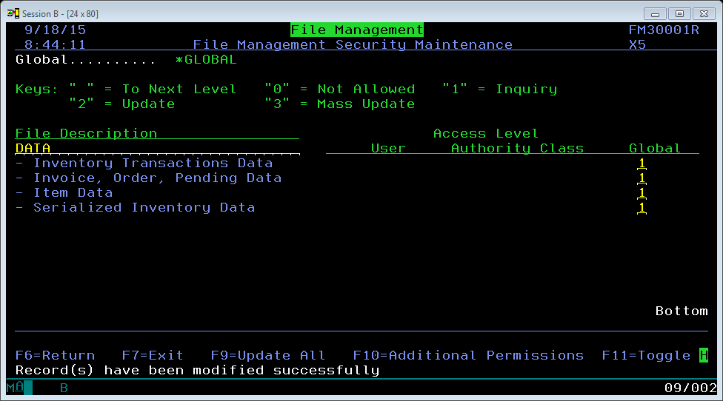
File Management Authority
Data Warehouses: Analyzing and Exporting Data

Slide 26
Navigator File Management Category
Data Warehouses: Analyzing and Exporting Data
New FM Category
Data Warehousing
All the Current FM Security
Inquiry Only
CSV/Excel Export

Slide 27
Why Navigator File Management?
Data Warehouses: Analyzing and Exporting Data
Known and Proven
Built-in Security
Built-in Private and Public Saved Filters
Built-in Column Selection and Column Sorting
Built-in CSV/Excel Extraction
Type of Use Case Envisioned when Building Navigator FM

Slide 28
Maintenance of Data Warehouses
Data Warehouses: Analyzing and Exporting Data
Activate Via System Settings (SET 004)
Search for “Data Warehouse”

Slide 29
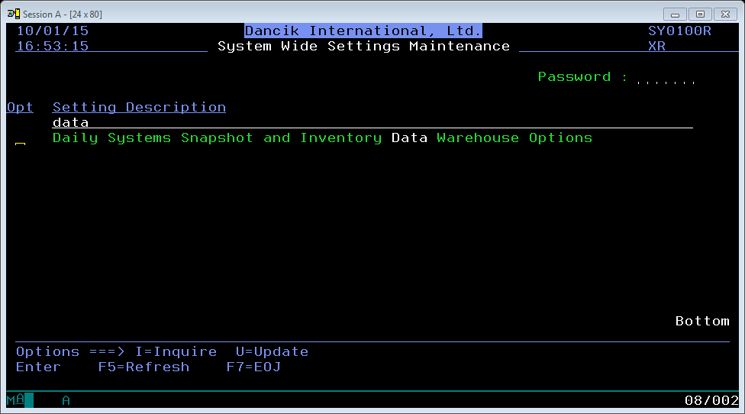
System Settings
Data Warehouses: Analyzing and Exporting Data

Slide 30
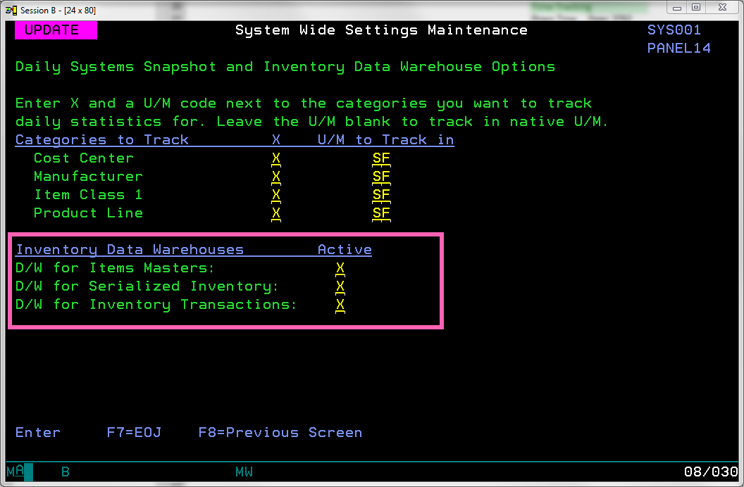
System Settings
Data Warehouses: Analyzing and Exporting Data

Slide 31
Maintenance of Data Warehouses
Data Warehouses: Analyzing and Exporting Data
Coming Soon:
SPEC 4539
Clear and rebuild Data Warehouses on your schedule
Prioritize Packaging Unit of Measures
Keeps the columns and order of Unit of Measures consistent

Slide 32
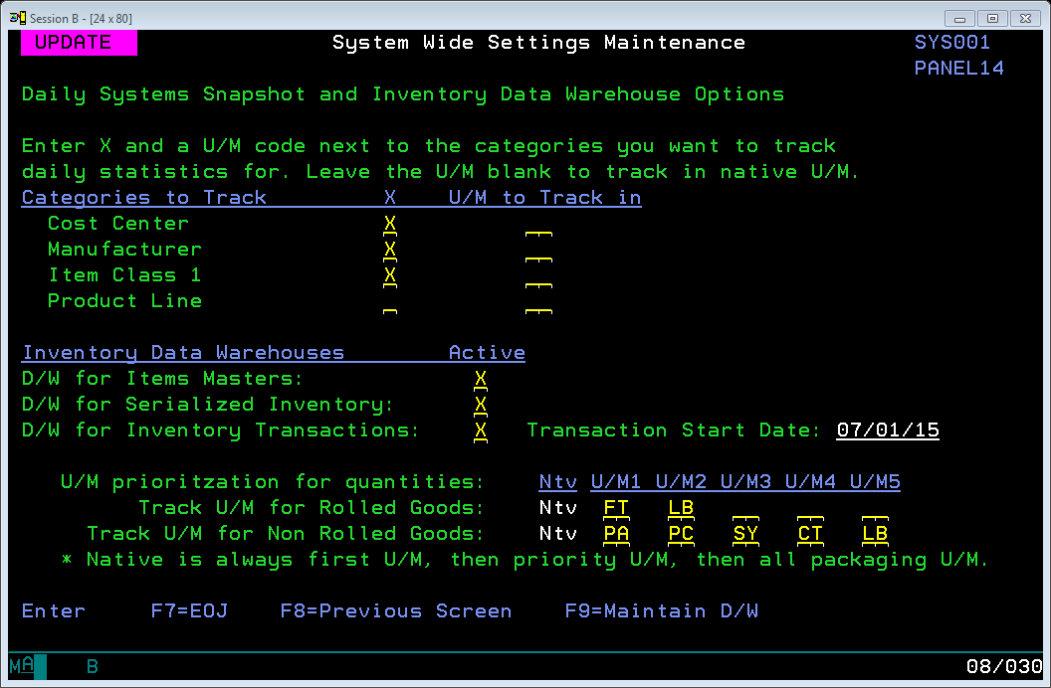
System Settings
Data Warehouses: Analyzing and Exporting Data

Slide 33
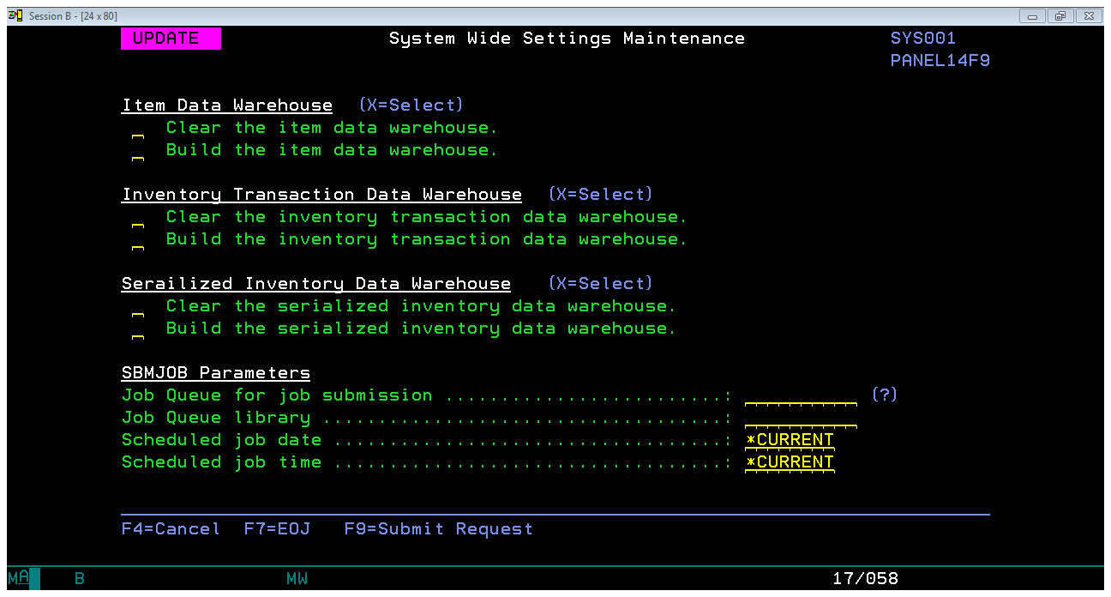
System Settings
Data Warehouses: Analyzing and Exporting Data

Slide 34
Next Data Warehouses
Data Warehouses: Analyzing and Exporting Data
You Tell Us!

